Slide 1
Story 10 Krishna’S Lesson Of Dharma To Arjuna On The Battlefield (Bhagavad Gita)
On the great battlefield of Kurukshetra, the mighty warrior Arjuna looked across at the opposing arm

Slide 2
On the great battlefield of Kurukshetra, the mighty warrior Arjuna looked across at the opposing army. His heart sank. He saw his cousins, the Kauravas, and even his wise teacher, Dronacharya. "My hands are trembling," he told his friend and charioteer, Krishna. "I cannot fight my own family! I will

Slide 3
drop my bow, Gandiva." Krishna, with a calm and loving smile, placed a hand on Arjuna’s shoulder. “Arjuna,” he said, “your duty as a Pandava prince is to stand up for what is right. The Kauravas have chosen a path of darkness and unfairness.” He continued, “It is your dharma—your

Slide 4
special job—to fight for truth. Do not worry about winning or losing. Just do your duty with a brave and pure heart. Standing up for good is the most important thing, even when it’s hard.” Hearing Krishna’s divine words, Arjuna’s confusion vanished. He understood. He picked up his powerful bow,

Slide 5
ready to fight for justice. *** **Moral of the story:** Sometimes, the right thing to do is also the hardest thing to do. We must always choose the path of duty and righteousness, no matter the obstacle.

Slide 6
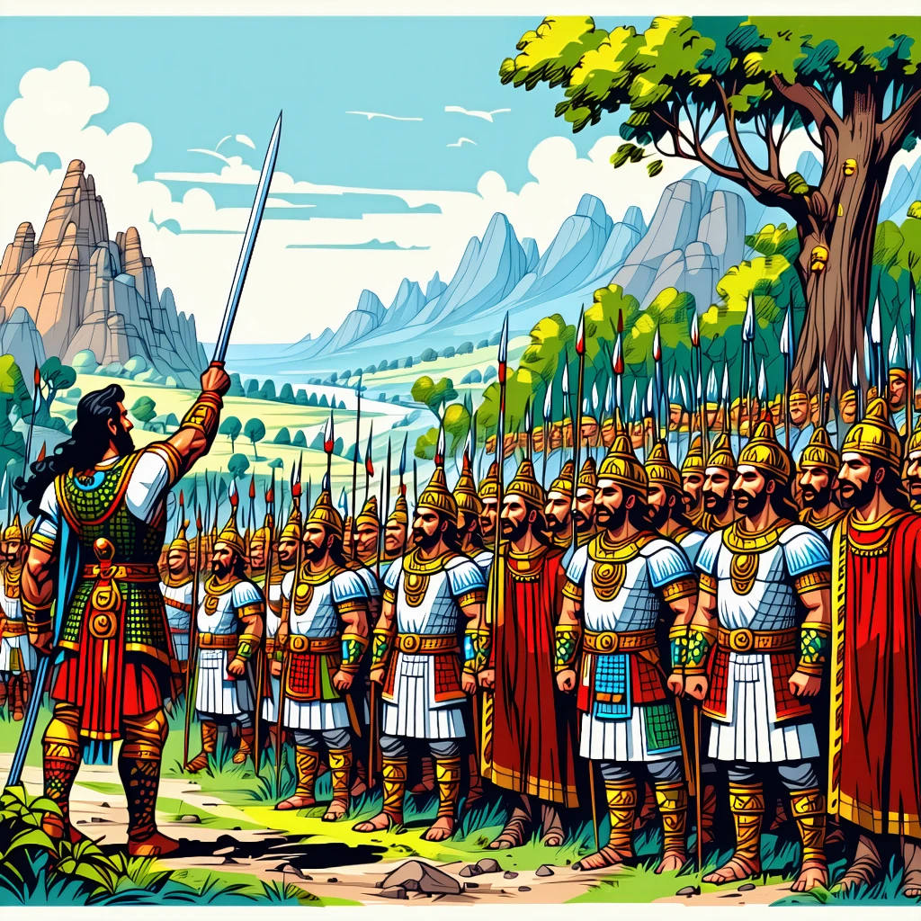

Slide 7
Story 1 Hanuman’S Bravery In Finding Sita
Hanuman, the mighty monkey warrior, saw his beloved Lord Rama with a sad heart. The wicked demon kin

Slide 8
Hanuman, the mighty monkey warrior, saw his beloved Lord Rama with a sad heart. The wicked demon king, Ravana, had captured the beautiful Princess Sita and hidden her on his island kingdom of Lanka. A vast, roaring ocean stood between them and Sita. While everyone else wondered what to do,

Slide 9
Hanuman’s heart filled with courage. He chanted Lord Rama’s name, and a magical power flowed through him. He grew bigger, and bigger, until he was as tall as a mountain! With a mighty roar, **"Jai Shri Ram!"** (Victory to Lord Rama!), Hanuman took a giant leap. He flew across the

Slide 10
sky like a golden arrow, soaring over the massive waves below. In Lanka, he bravely snuck past giant demons and finally found Sita in a beautiful garden called the Ashoka Vatika. He gave her Rama’s ring, assuring her that help was on its way. Hanuman’s single act of bravery brought

Slide 11
hope to everyone. *** **Moral of the story:** With courage in your heart and faith in doing the right thing, no ocean is too wide and no challenge is too big.

Slide 12
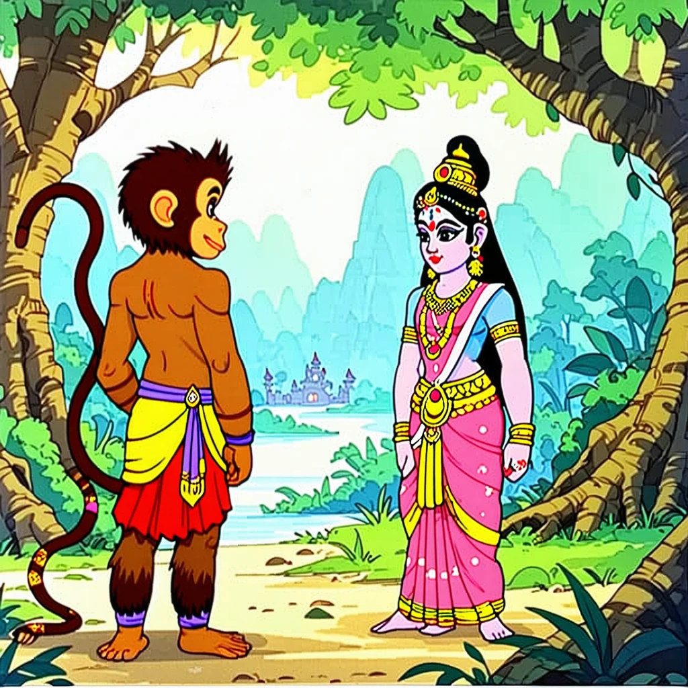

Slide 13
Story 2 The Pandavas’ Teamwork In Building The Indraprastha Palace
The five Pandava brothers stood on a dry, thorny land called Khandavaprastha. It looked sad and empt

Slide 14
The five Pandava brothers stood on a dry, thorny land called Khandavaprastha. It looked sad and empty. But their dear friend, Lord Krishna, smiled. "Together," he said, "you can turn this into paradise!" So, they got to work as a team! Yudhishthira, the wise king, drew a master plan for

Slide 15
a grand city. Mighty Bhima used his super strength to clear heavy rocks and trees, tossing them like pebbles. Brave Arjuna stood guard with his powerful bow, Gandiva, protecting everyone. The clever twins, Nakula and Sahadeva, planned beautiful gardens and magnificent stables for their horses. They were helped by Maya

Slide 16
Danava, a magical architect. He built a palace so dazzling it tricked the eyes! It had shiny floors that looked like flowing water and pools that looked like solid crystal. Soon, the thorny land was transformed into the magnificent city of Indraprastha, a jewel on the earth. The brothers looked

Slide 17
at their wonderful home and knew they had built it with something stronger than magic: teamwork. **Moral of the story:** Just like how Lord Rama’s Vanara Sena built a bridge to Lanka, the Pandavas showed that when we work together and combine our unique skills, we can create wonders.

Slide 18
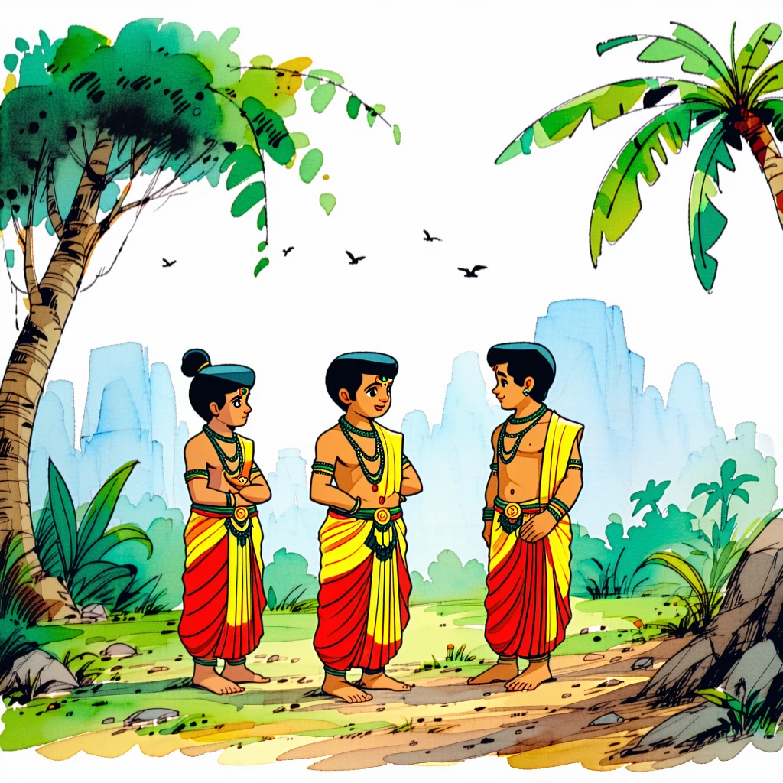

Slide 19
Story 3 Rama’S Kindness Towards Shabari
Deep in a quiet forest lived a kind, elderly woman named Shabari. Every day, she would clean the pat

Slide 20
Deep in a quiet forest lived a kind, elderly woman named Shabari. Every day, she would clean the path to her little hut, gather the sweetest wild berries, and wait. Her great teacher had told her that one day, the noble Prince Rama would visit her. Years passed, and Shabari

Slide 21
grew old, but her faith never wavered. One sunny morning, two tired princes arrived at her doorstep. It was Rama and his brother, Lakshmana! Shabari’s eyes sparkled with happy tears. She lovingly offered Rama the berries she had collected. To ensure each berry was perfectly sweet, she took a tiny

Slide 22
bite first before giving it to him. Lakshmana was surprised, but Rama smiled gently. He wasn't looking at the half-eaten fruit; he was looking at the pure love and devotion in Shabari's heart. He ate the berries gratefully, tasting her kindness in every bite. Her lifelong wish fulfilled, Shabari felt

Slide 23
a deep, peaceful joy. **Moral of the story:** True kindness and love in your heart are more precious than any rich gift. God sees our devotion, not just our offerings.

Slide 24
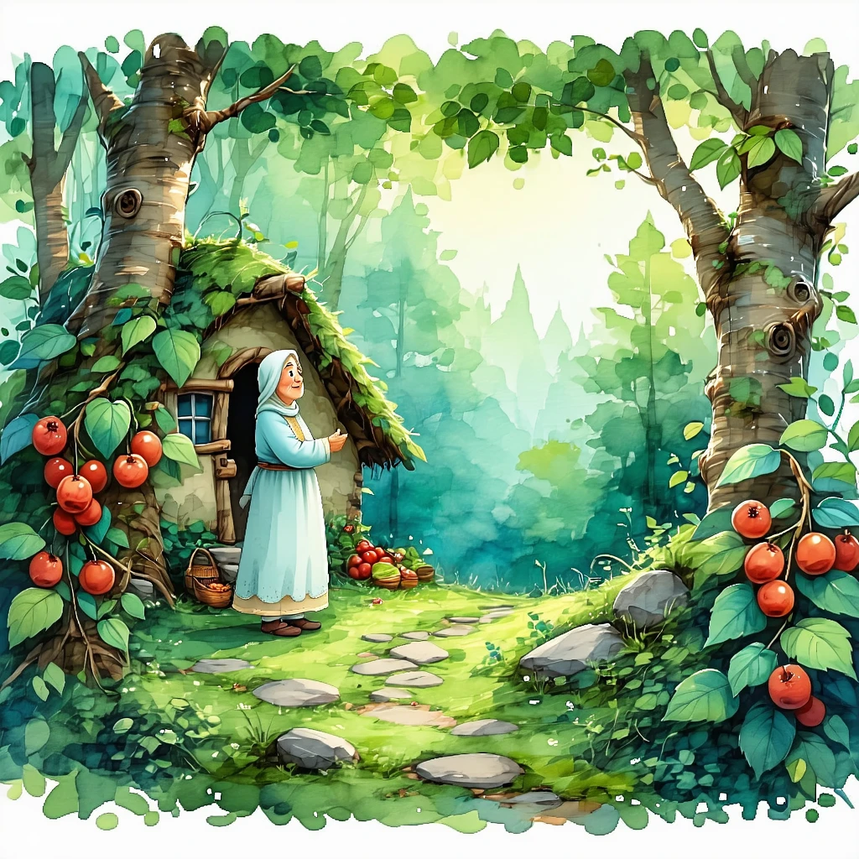

Slide 25
Story 4 Abhimanyu’S Bravery In The Chakravyuh
In the great war of Mahabharata, the wicked Kauravas created a deadly trap called the Chakravyuh—a s

Slide 26
In the great war of Mahabharata, the wicked Kauravas created a deadly trap called the Chakravyuh—a spinning wheel of soldiers, impossible to break. The mighty Pandavas were worried. Who could face this challenge? Suddenly, the brave young prince Abhimanyu, son of the great archer Arjuna, stepped forward. "I can do

Slide 27
it!" he declared. He had learned the secret of entering the Chakravyuh while he was still a baby in his mother Subhadra’s tummy, listening to his father. Like a flash of lightning, Abhimanyu charged into the maze on his chariot. Inside, he fought like a young lion, defeating powerful warriors

Slide 28
one by one. His arrows flew like shooting stars! Though he was alone and trapped, his heart knew no fear. He fought with incredible skill and courage, amazing even his enemies. He fought to protect his family’s honor until his very last breath. *** **Moral of the story:** Abhimanyu’s tale,

Slide 29
much like the courage of Jatayu trying to save Sita in the Ramayana, teaches us that true bravery isn't about winning. It's about facing your biggest fears with all your heart and fighting for what is right, no matter how difficult it seems.

Slide 30
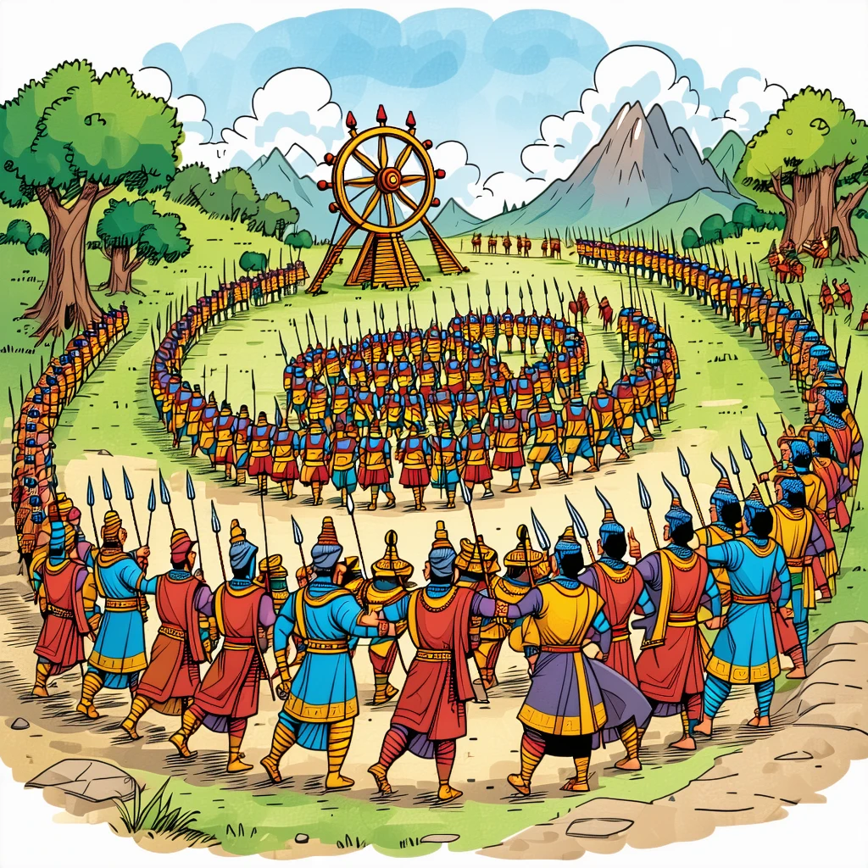

Slide 31
Story 5 Sita’S Strength During Her Time In Lanka
Of course! Here is a short story for children about Sita's strength.
***
### The Unbreakable Spiri

Slide 32
Of course! Here is a short story for children about Sita's strength. *** ### The Unbreakable Spirit Princess Sita was far from her beloved Rama. She was in Lanka, in a beautiful garden called the Ashoka Vatika. But even with fragrant flowers all around, she was sad. The ten-headed king,

Slide 33
Ravana, would often visit. "Marry me, Sita!" he would boom. "I will give you gold palaces and sparkling jewels!" But Sita was stronger than any jewel. She would stand tall, her eyes full of courage, and say, "A palace is just a cage without love and respect. My heart belongs

Slide 34
only to Rama." The guards around her would try to scare her, but Sita found strength in small things. She would talk to the trees, remembering her walks in the forest with Rama. She held onto her hope like a tiny, warm light in the dark. One day, the mighty

Slide 35
Hanuman found her. He offered to carry her back to safety. But Sita, with great dignity, said, "Thank you, brave Hanuman. But it is Rama's dharma (duty) to defeat injustice and rescue me. Tell him I am waiting, and my spirit is not broken." **Lesson:** True strength isn't about fighting

Slide 36
with fists. It's the courage and hope you hold inside your heart, even when you are scared or alone.

Slide 37
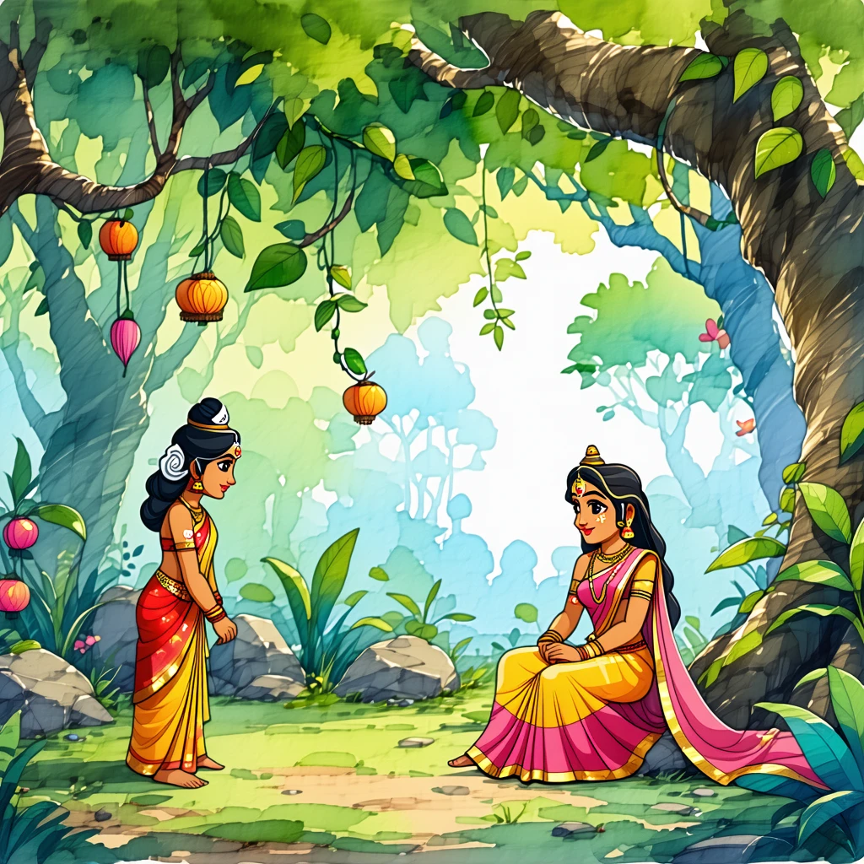

Slide 38
Story 6 Bhishma’S Promise To His Father, Shantanu
Of course! Here is a short story for children based on Bhishma's promise.
***
### The Prince's Pro

Slide 39
Of course! Here is a short story for children based on Bhishma's promise. *** ### The Prince's Promise Once, in a kingdom by the river Ganga, lived a brave and loving prince named Devavrata. His father, King Shantanu, was the kindest king, but lately, he had been very sad. Devavrata

Slide 40
couldn’t bear to see his father unhappy. He discovered that the king was in love with a beautiful fisherwoman named Satyavati, but her father would only agree to the marriage if *her* children became the future kings. This was a problem, as Prince Devavrata was the rightful heir to the

Slide 41
throne! To bring the smile back to his father's face, Devavrata went to Satyavati’s father and made a powerful promise. "I will give up my right to be king," he declared. But the fisherman was still worried. "What if your children claim the throne one day?" So, Devavrata made an

Slide 42
even bigger, more incredible promise. "Then I shall never marry and never have children." The gods in the heavens were so amazed by his sacrifice that they showered flowers upon him and gave him a new name: **Bhishma**, meaning “He of the incredible vow.” He kept his promise for his

Slide 43
entire life, all for his father's happiness. **Lesson of the story:** Keeping a promise and honoring your family are among the greatest acts of love. A person who puts others' happiness before their own is truly noble.

Slide 44
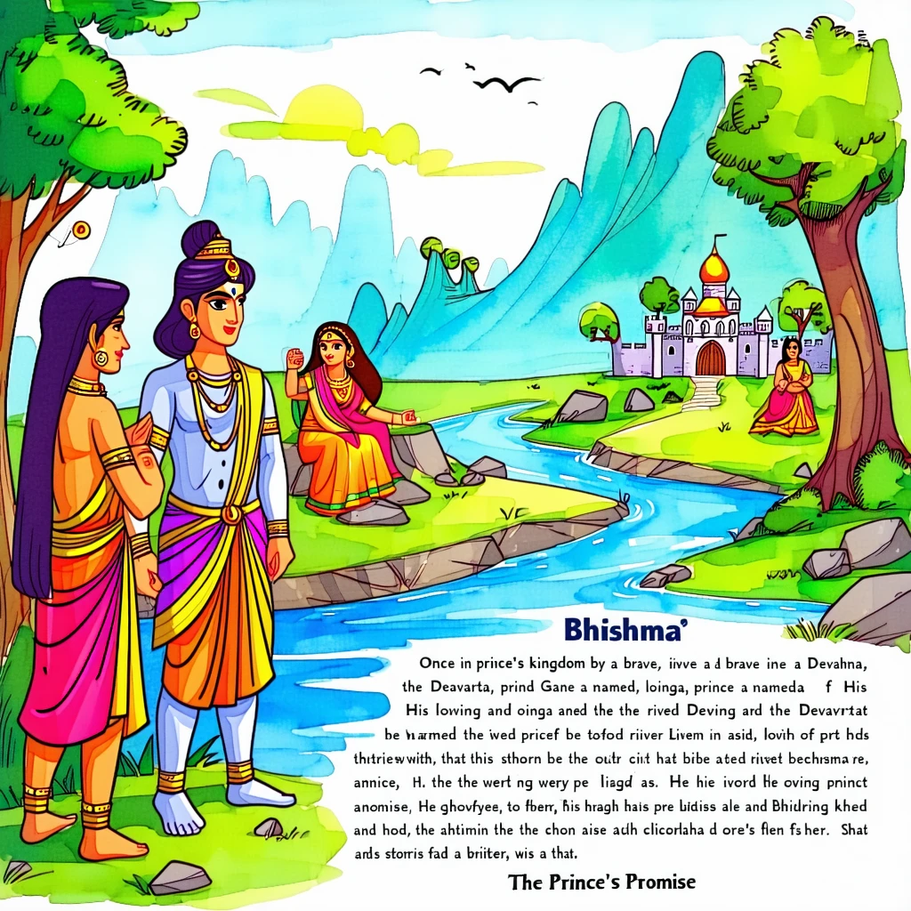

Slide 45
Story 7 Jambavan’S Wisdom In Reminding Hanuman Of His Powers
The mighty Vanara army stood at the edge of a vast, roaring ocean. They had found where Ravana had h

Slide 46
The mighty Vanara army stood at the edge of a vast, roaring ocean. They had found where Ravana had hidden Sita—on the island of Lanka! But how could they cross the endless water? Everyone felt hopeless. Even the brave Hanuman sat quietly, staring at the waves. He felt small and

Slide 47
powerless, having forgotten his own divine gifts. Just then, wise old Jambavan, the king of the bears, walked up to him. With a kind smile, he said, "Hanuman, my son, why do you sit in silence? Have you forgotten who you are?" "You are the son of Vayu, the Wind

Slide 48
God! As a baby, you leaped thousands of miles into the sky, thinking the bright sun was a juicy mango. This tiny ocean is nothing for you!" Hearing these words, Hanuman’s eyes widened. He remembered! A powerful energy surged through him. He grew bigger and stronger, until he was as

Slide 49
tall as a mountain. With a mighty roar, he declared, “I remember! For Lord Ram, I will cross this ocean!” *** **Moral of the story:** Sometimes we forget how strong and special we are. A wise friend’s encouragement can help us remember our own hidden powers.

Slide 50
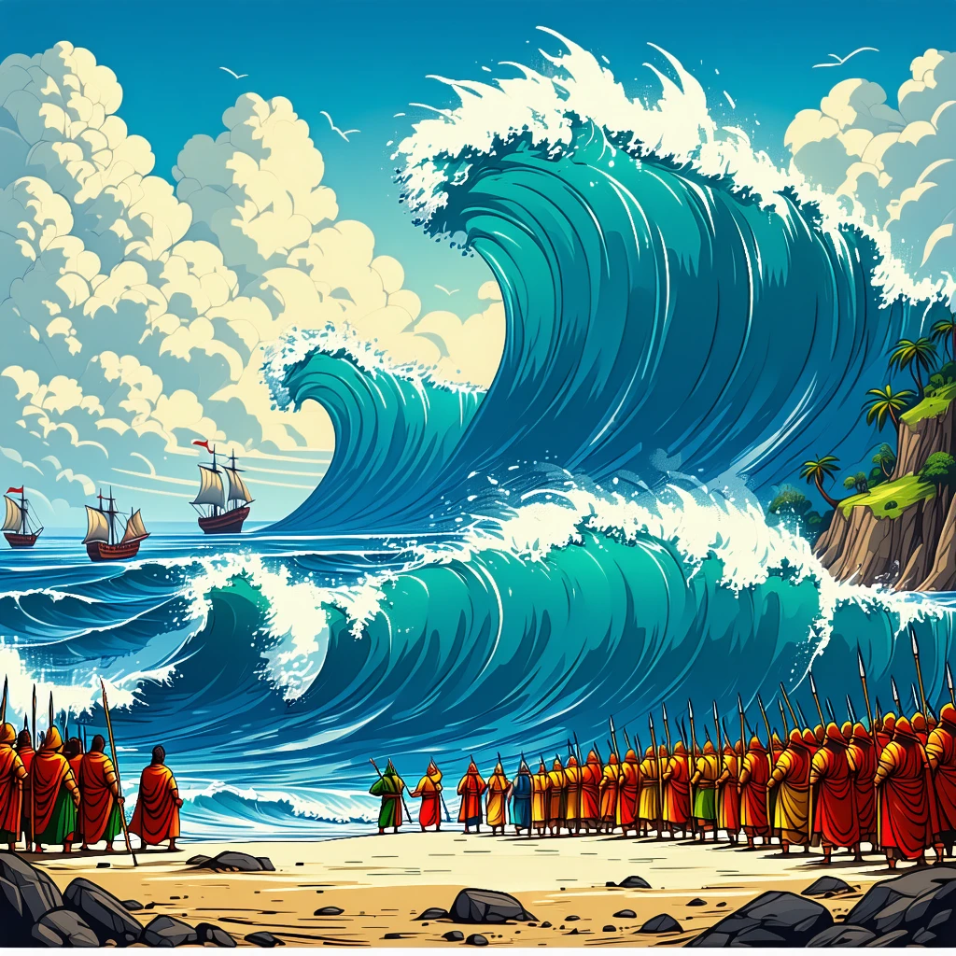

Slide 51
Story 8 Draupadi’S Courage During The Game Of Dice
In the grand kingdom of Hastinapur, the five noble Pandava princes were tricked by their jealous cou

Slide 52
In the grand kingdom of Hastinapur, the five noble Pandava princes were tricked by their jealous cousins, the Kauravas, in a game of dice. They lost their kingdom, their wealth, and even their freedom. The wicked prince Duryodhana then ordered his brother to bring the Pandavas' wife, the brave Queen

Slide 53
Draupadi, to the court. But Draupadi was filled with courage. Instead of being scared, she stood tall and her voice rang out like a lioness’s roar. "You have no right to command me!" she declared. "A king who has lost himself has no power to stake anyone else!" Ignoring her

Slide 54
words, the cruel men tried to dishonour her by pulling at her sari. Draupadi closed her eyes and prayed with all her might to Lord Krishna. A miracle unfolded! As they pulled her sari, it magically kept getting longer and longer, piling up in a mountain of beautiful cloth. The

Slide 55
villains grew tired and fell back in shame, defeated by her unbreakable spirit. *** **Moral of the story:** True strength is not in muscles, but in courage and faith. When you stand up for what is right, even when you are alone, the universe will come to your aid.

Slide 56
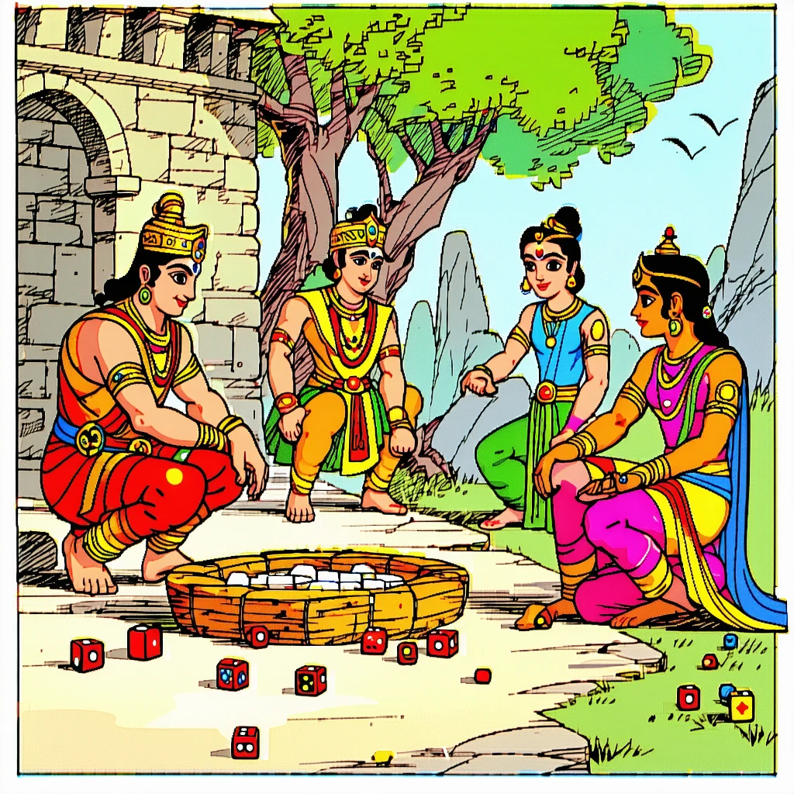

Slide 57
Story 9 Lakshmana’S Dedication To Protecting Rama And Sita
### The Guardian of the Night
Deep in the Dandaka forest, the sun dipped below the horizon, paintin

Slide 58
### The Guardian of the Night Deep in the Dandaka forest, the sun dipped below the horizon, painting the sky in shades of orange and pink. Prince Rama and his beloved wife, Sita, were tired after a long day. They made a soft bed of leaves under a giant banyan

Slide 59
tree and soon fell into a peaceful sleep. But Rama’s younger brother, Lakshmana, did not rest. With his bow in hand and an arrow ready, he stood guard. The forest was full of strange sounds—the hoot of an owl, the rustle of unseen animals, the whisper of the wind. Lakshmana’s

Slide 60
eyes scanned the darkness, watching for any danger. He drew an imaginary circle of protection around Rama and Sita with his love and courage. All night, he stood like a silent, unmoving warrior. When the sun rose, Rama and Sita awoke feeling safe and refreshed. They saw Lakshmana, still standing

Slide 61
guard with a gentle smile on his face. Rama placed a hand on his brother’s shoulder, his heart full of love. He knew that while they slept, Lakshmana’s devotion had been their strongest shield. *** **Moral of the story:** True love and devotion are shown not just in words, but

Slide 62
in selfless actions to protect and care for our family.

Slide 63
